Slide 1
Sales Dataset Analysis – Advanced Excel Project
SUBHIKSHA
13-12-2024
DADS OCTOBER BATCH

Slide 2
Project analysis slide 5
Project Overview & Objectives
Project objectives
To analyse the sales performance over the past year, identify trends, and uncover opportunities for growth. We aim to provide actionable insights for the sales management team to optimize strategies and improve performance.
Goals
Analyze sales trends over time.
Identify high-performing products and sales channels.
Determine the impact of returns and discounts.
Create a dynamic dashboard with key metrics.

Slide 3
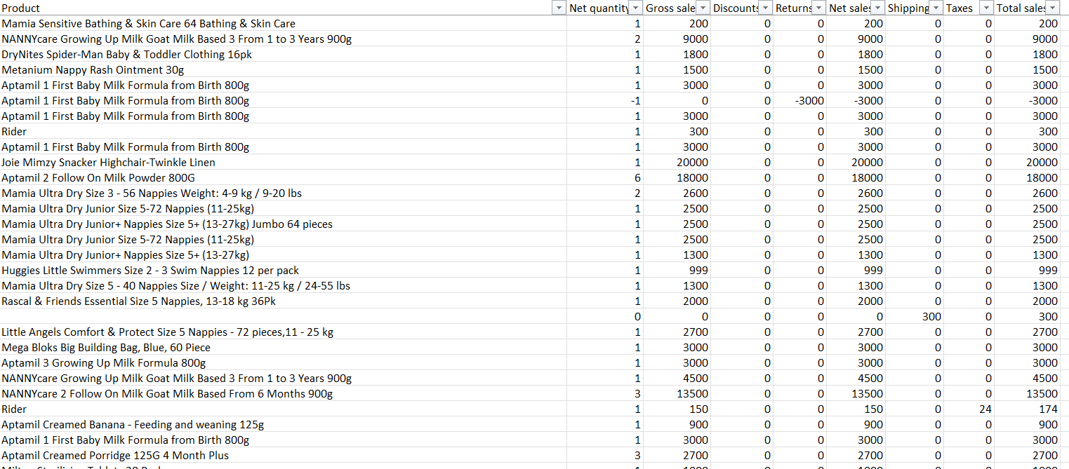
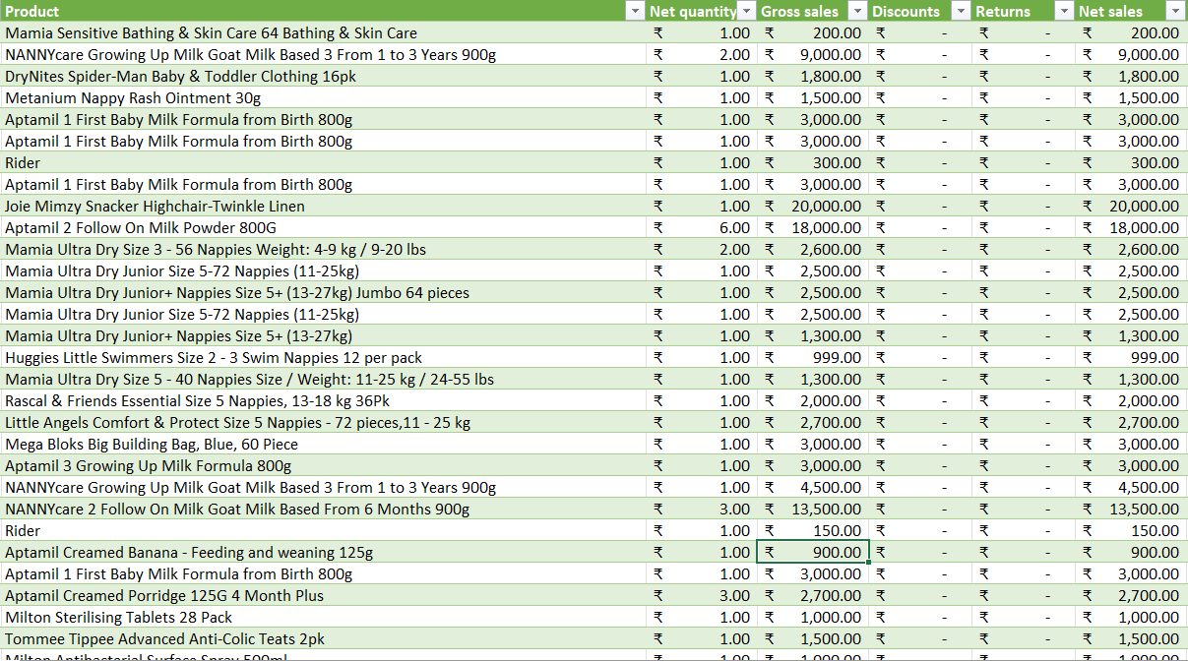
Project analysis slide 5
Data Description & Presentation
Raw data
Cleaned data
Dataset overview
Data cleaning process
The dataset contains 27,638 rows and 17 columns such as Order ID, Sale ID, Date, Sale type, Transaction type etc.,
Removing duplicate rows or blank entries
Date formatting
Bold headers and freeze top row
Used Power Query to import, clean, and transform the data by filtering, removing duplicates, and handling null values.

Slide 4
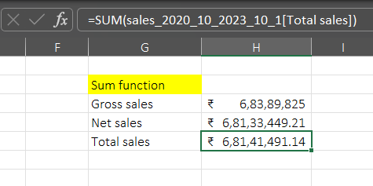
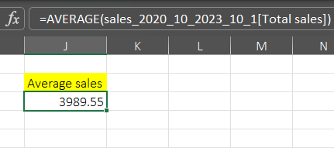
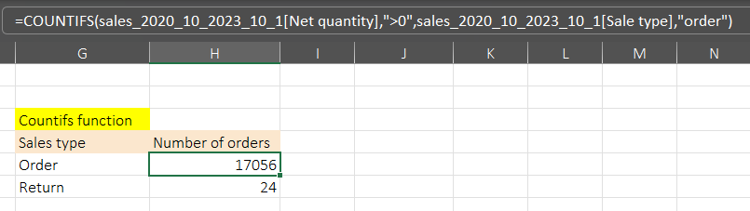
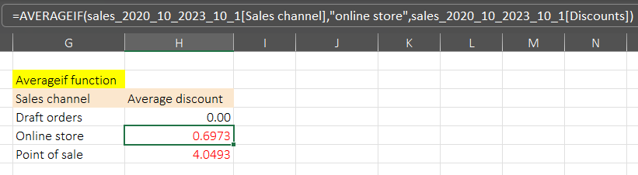
Project analysis slide 5
Key metrics calculation & Data Analysis
Calculations
Total sales (Gross, Net, Adjusted)
Average sales per order
Count of orders
Sales by channel/product type

Slide 5
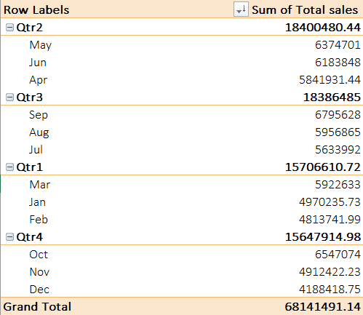
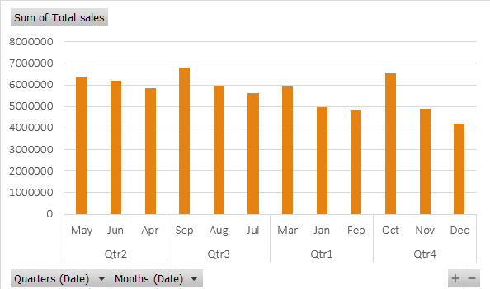
Project analysis slide 5
Pivot Tables and Pivot Charts
Pivot Tables
Pivot Charts
Pivot tables are used to summarize a large amount of data by dimensions like Date, sales category, product type etc.,
Pivot Charts were used to visualize sales trends over time or by product type.

Slide 6
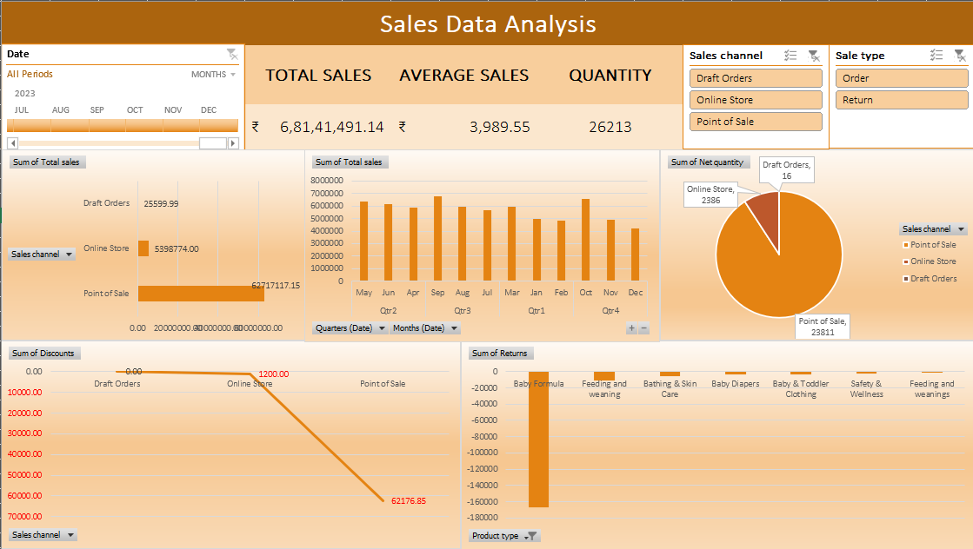
Project analysis slide 10
Dashboard Overview

Slide 7
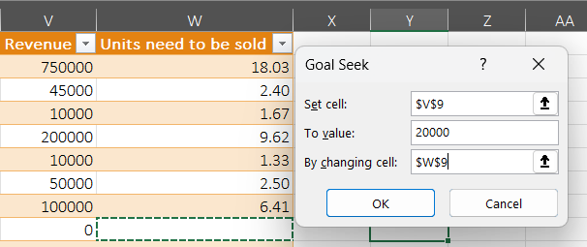
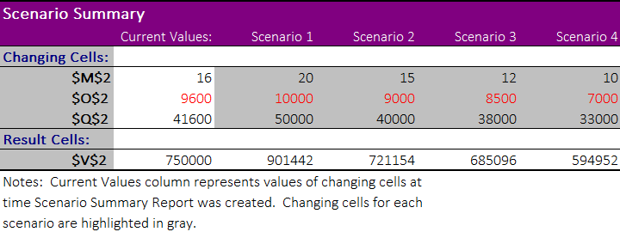
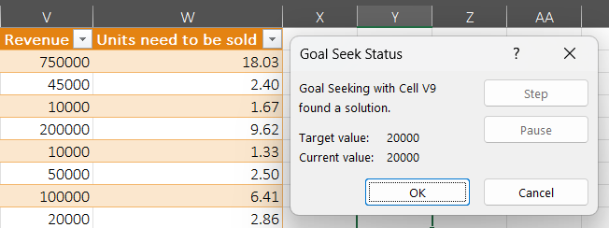
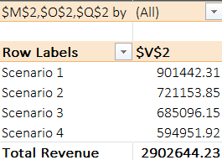
Project analysis slide 5
What-If Analysis and Goal Seek
Goal seek
What-if Analysis
Goal seek is a tool in Excel that helps you find the input value needed to achieve a desired output in a formula.
What-If Analysis in Excel is a tool that allows users to change cell values to see how the outcome of worksheet formulas will be affected.

Slide 8
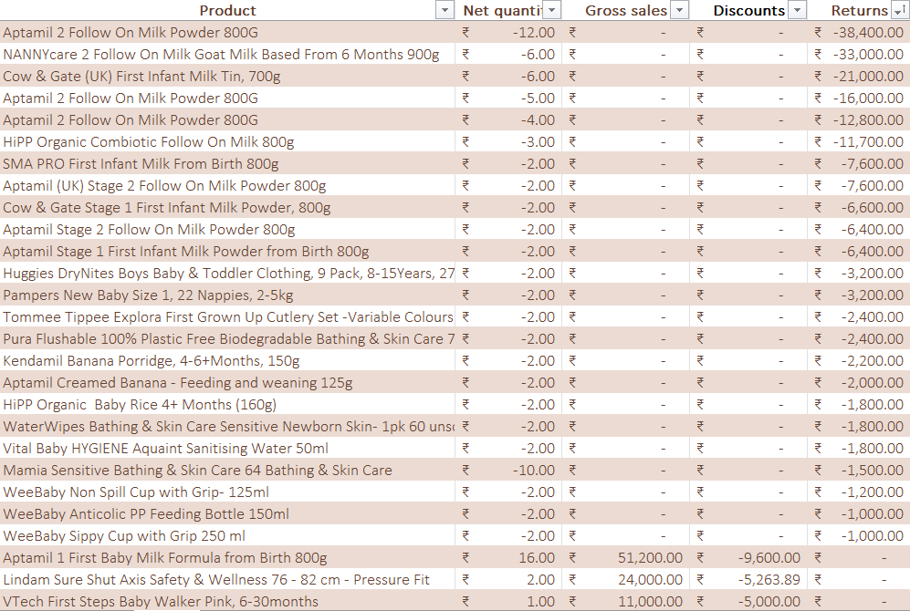
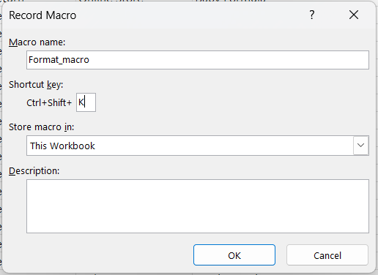
Project analysis slide 11
Macros and Automation
A Macro in Excel is a set of actions that can be recorded and run repeatedly to automate tasks.

Slide 9
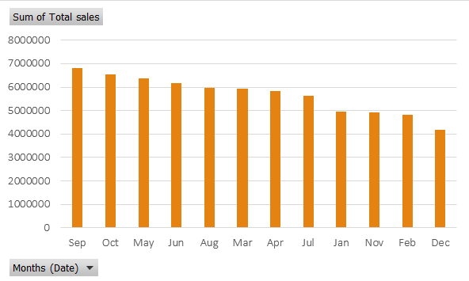
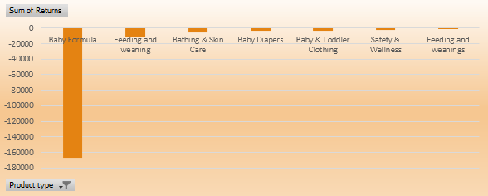
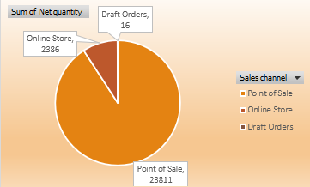
Project analysis slide 5
Insights and Recommendations
Key Insights
The store has experienced significant overall growth in sales, particularly in the month of September.
The Baby Formula product sold Online stores sales channel has the more number of returns.
The Point of sale (Sales channel) has sold the highest number of orders which increased the total revenue of the store.
In providing Discounts, the Point of sale (Sales channel) has comparatively provided more discount to the customers.

Slide 10
Project analysis slide 5
Conclusion
Recommendations
The store should increase the promotions in the month of January, February, November and December to maintain a good average total revenue.
The store should focus on the quality of the products to reduce the return rates.
The store should also provide advertisements regarding the online store to boost the number of orders placed and the sales.
One of the way of increasing the sales in the Online store is to increase the Discount rate to attract a large number of customers worldwide.

Slide 11
Thank You

